Slide 1

Introduction to Environmental Sciences
By – KANAGARAJ.R
Research Scholar
Dept of Environmental Engineering

Slide 2
UNIT-1

Slide 3
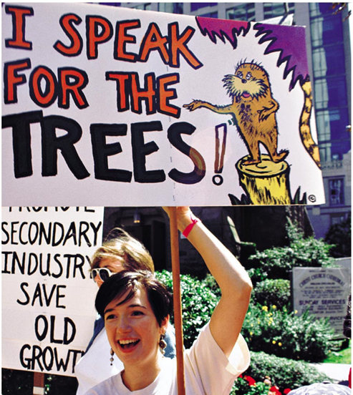
Environment
The word “Environment” is originated from French environ means ‘around’ or ‘to surround’ or ‘to encompass’. This means that environment includes things or objects or events that surround us. But this definition is not enough. This needs to be enlarged to include that there is interaction between objects and surrounding. It is the interaction between living beings (plants and animals) and its environment that includes physical non-living components like oceans or land or mountains. It also includes interaction among living beings.

Slide 4
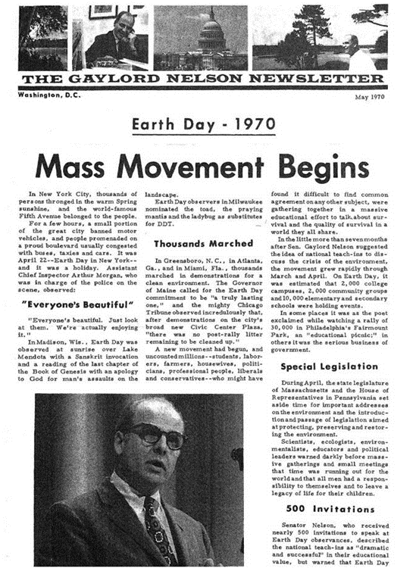
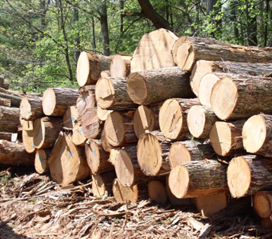
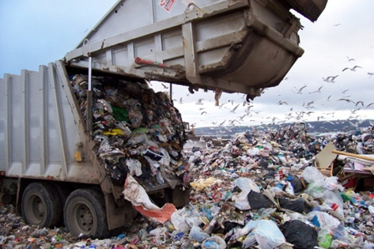
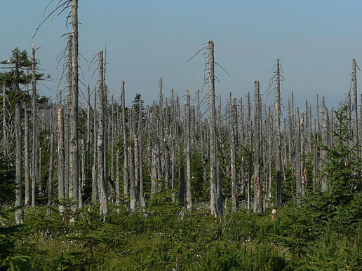
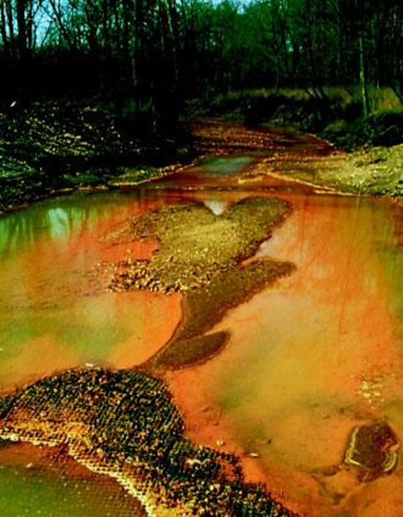
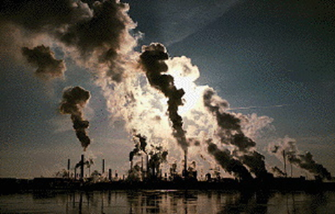
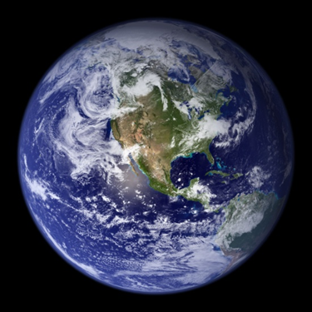

Slide 5
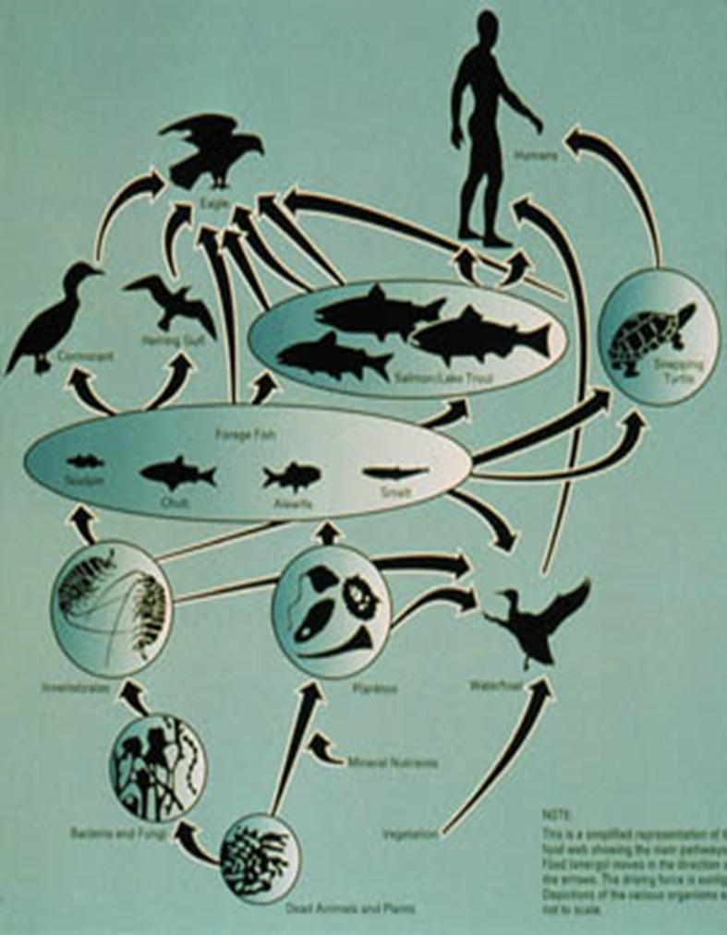
Definition
Environmental studies deals with every issue that affects an organism. It is essentially a multidisciplinary approach that brings about an appreciation of our natural world and human impacts on its integrity. It is an applied science as its seeks practical answers to making human civilization sustainable on the earth’s finite resources.
‘The term environment is used to describe, in the aggregate, all the external forces, influences and conditions, which affect the life, nature, behaviour and the growth, development and maturity of living organisms- – Douglas and Holland

Slide 6
Scope
As we look around at the area in which we live, we see that our surroundings were originally a natural landscape such as a forest, a river, a mountain, a desert, or a combination of these elements.
Most of us live in landscapes that have been heavily modified by human beings, in villages, towns or cities.
But even those of us who live in cities get our food supply from surrounding villages and these in turn are dependent on natural landscapes such as forests, grasslands, rivers, seashores, for resources such as water for agriculture, fuel wood, fodder, and fish.
Our dependence on nature is so great that we cannot continue to live without protecting the earth’s environmental resources. Thus most traditions refer to our environment as ‘Mother Nature’ and most traditional societies have learned that respecting nature is vital for their livelihoods.
The scope of environmental studies is very large. We have today, fairly good knowledge of this subject especially the environmental problems that concern us and our future on this planet. Some of the problems are global because they affect everyone in the world.

Slide 7
Scope
The study tries to identify and develop appropriate and indigenous eco-friendly skills and technologies to various environmental issues.
It teaches the citizens the need for sustainable utilization of resources as these resources are inherited from our ancestors to the younger generation without deteriorating their quality.
It provides necessary information about biodiversity richness and the potential dangers to the species of plants, animals and microorganisms in the environment.
The study enables theoretical knowledge into practice and the multiple uses of environment.
The study tries to identify and develop appropriate and indigenous eco-friendly skills and technologies to various environmental issues.
It teaches the citizens the need for sustainable utilization of resources as these resources are inherited from our ancestors to the younger generation without deteriorating their quality.

Slide 8
OBJECTIVES
To know and understand true aspects of the environment in general
Inculcate the attitude in using the knowledge and skills towards solving problem and issues related to individuals, society and the environment.
Build understanding, awareness and sensitivity towards causes and efforts of the class that continuously take place in society the world around us.
To build the values and attitudes towards the need and necessity to live together in harmony in the context of the heterogeneous society.
To know and understand the interaction between mammals, between human and their environment and interaction between the various elements and components of the environment.

Slide 9
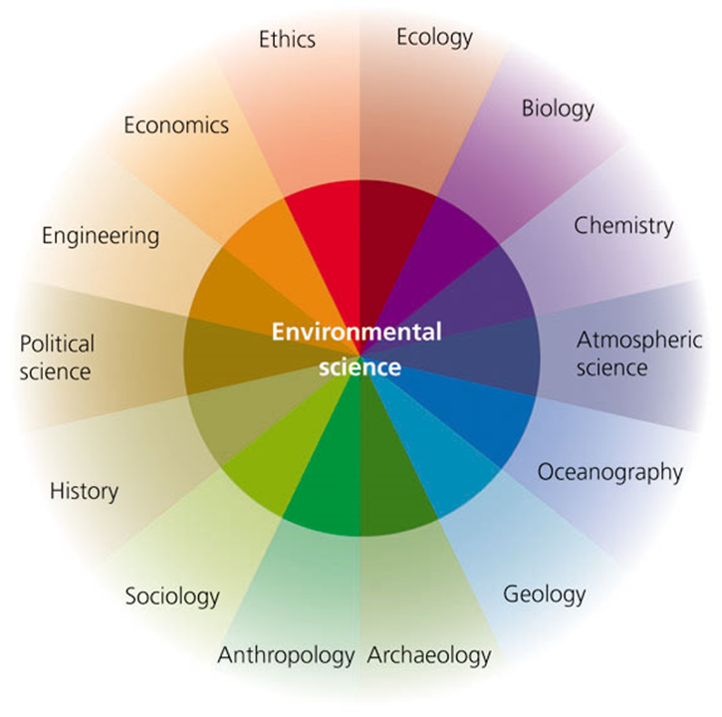
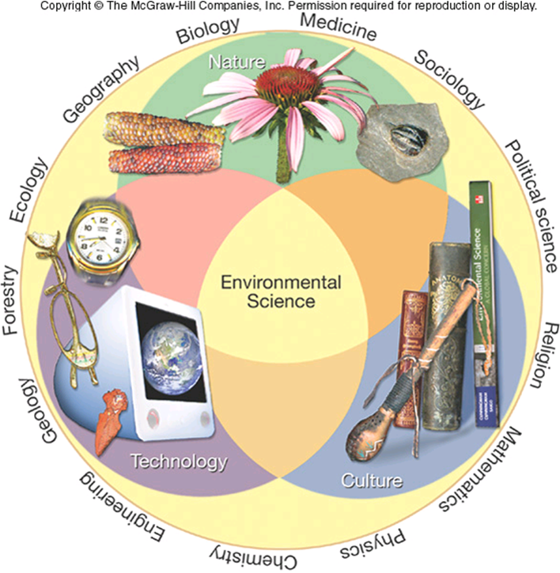
Role of Environmental Studies

Slide 10
Activity 1
Take any article that you use in daily life – a bucket full of water, or an item of food, a table, or a book. Trace its components journey backwards from your home to their origins as natural resources in our environment. How many of these components are renewable resources and how many non-renewable?

Slide 11
Importance of environmental study
Environmental study is based upon a comprehensive view of various environmental systems. It aims to make the citizens competent to do scientific work and to find out practical solutions to current environmental problems. The citizens acquire the ability to analyse the environmental parameters like the aquatic, terrestrial and atmospheric systems and their interactions with the biosphere.
World population is increasing at an alarming rate especially in developing countries.
The natural resources endowment in the earth is limited.
The methods and techniques of exploiting natural resources are advanced.
The resources are over-exploited and there is no foresight of leaving the resources to the future
generations.
The unplanned exploitation of natural resources lead to pollution of all types and at all levels.

Slide 12
The pollution and degraded environment seriously affect the health of all living things on earth, including man.
The people should take a combined responsibility for the deteriorating environment and begin to take appropriate actions to space the earth.
Education and training are needed to save the biodiversity and species extinction.
Need for an Alternative Solution: It is essential, especially for developing countries to
find alternative paths to an alternative goal. We need a goal as under:
A goal, which ultimately is the true goal of development an environmentally sound and sustainable development.
A goal common to all citizens of our earth.
A goal distant from the developing world in the manner it is from the over consuming wasteful societies of the “developed” world.

Slide 13
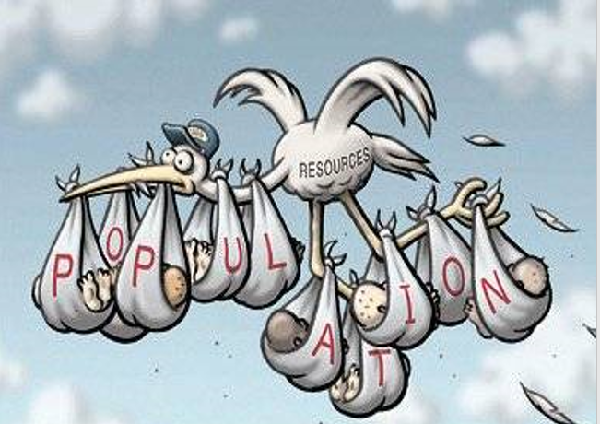
Need for Public Awareness
It is essential to make the public aware of the formidable consequences of the Environmental Degradation, if not retorted and reformative measures undertaken would result in the extinction of life. We are facing various environmental challenges. It is essential to get the country acquainted with these challenges so that their acts may be eco-friendly. Some of these challenges are as under:
Growing Population: A population of over thousands of millions is growing at 2.11 per cent every year. Over 17 million people are added each year. It puts considerable pressure on its natural resources and reduces the gains of development. Hence, the greatest challenge before us is to limit the population growth. Although population control does automatically lead to development, yet the development leads to a decrease in population growth rates. For this development of the women is essential.

Slide 14
Poverty: India has often been described a rich land with poor people. The poverty and environmental degradation have a nexus between them. The vast majority of our people are directly dependent on the nature resources of the country for their basic needs of food, fuel shelter and fodder. About 40% of our people are still below the poverty line. Environment degradation has adversely affected the poor who depend upon the resources of their immediate surroundings. Thus, the challenge of poverty and the challenge environment degradation are two facets of the same challenge.
Agricultural Growth: The people must be acquainted with the methods to sustain and increase agricultural growth with damaging the environment. High yielding varieties have caused soil salinity and damage to physical structure of soil.
Evil Consequences of Urbanisation: Nearly 27 per cent Indians live in urban areas. Urbanisation and industrialisation has given birth to a great number of environmental problems that need urgent attention. Over 30 percent of urban Indians live in slums. Out of India’s 3,245 towns and cities, only 21 have partial or full sewerage and treatment facilities. Hence, coping with rapid urbanization is a major challenge.

Slide 15
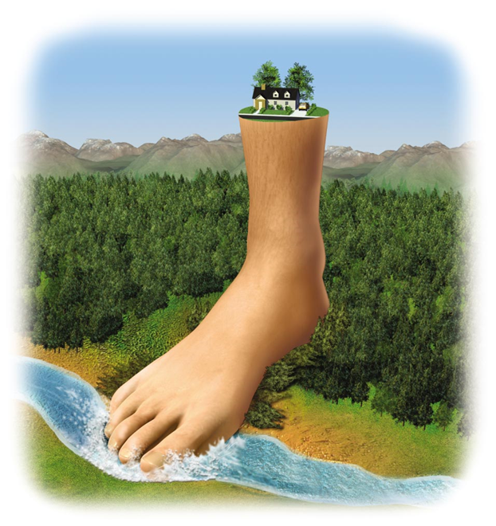
We are using 30% more of the planet’s resources than are available on a sustainable basis!
Each year, millions of people die from pollution
We have used up ½ of the world’s oil supplies; how will we handle this imminent fossil fuel shortage?
The growth rate has slowed, but we still add more than 200,000 people to the planet each day

Slide 16
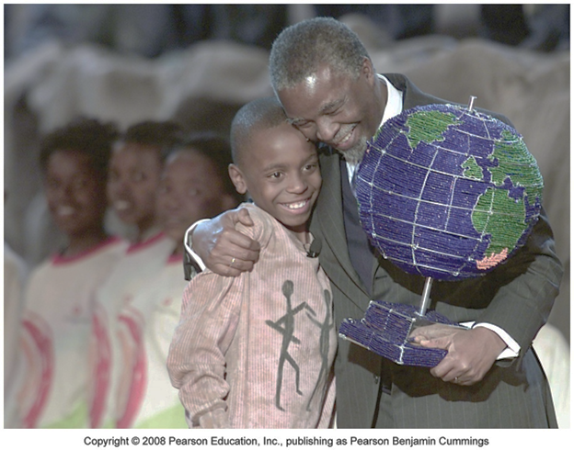
Self Assessment
State whether the following statements are true or false:
A population of over thousands of millions is growing at 4.11 per cent every year.
High yielding varieties have caused soil salinity and damage to physical structure of soil.
Urbanisation and industrialisation has given birth to a great number of environmental problems.

Slide 17
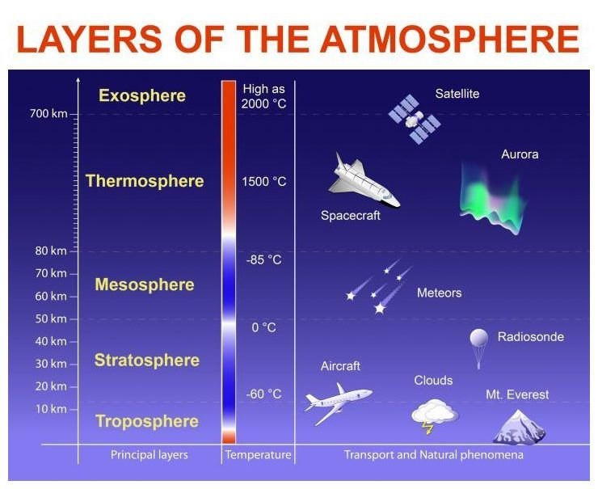
Segments of Environment
Atmosphere - The atmosphere refers to the protective blanket of gases, surrounding the earth. It sustains life on the earth. It saves the Earth from the hostile environment of the outer space. The atmosphere composed of nitrogen and oxygen in large quantity along with small percentage of other gases such as argon, carbon dioxide, and trace gases (the gases which makes up less than 1 percent by volume of the atmosphere.

Slide 18
Hydrosphere - Hydrosphere comprises all water resources such as ocean, seas, lakes, rivers, reservoirs, icecaps, glaciers, and ground water.
Lithosphere - It is the outer mantle of the solid earth. It contains minerals occurring in the earth’s crust and the soil.
Biosphere - It constitutes the realm of living organisms and their interactions with the environment (atmosphere, hydrosphere, and lithosphere).
The study of ecosystem or environmental studies has been seen to be multidisciplinary in nature, hence, it is considered to be a subject with great scope. It is no more confined only to the issues of sanitation and health; rather, it is now concerned with pollution control, biodiversity conservation, waste management and conservation of natural resources.

Slide 19
Segments of Environment
Geosphere (Lithosphere): Crust: < 1% (Thin) Everest: 8.85 km Mantle, Cores
Hydrosphere: (oceans) Mariana Trench (6.9mi) ~ 0.2 %
Atmosphere: ~1%: 30 km (99% of air) extends to 120 km
Biosphere:Biosphere indicates the realm of living organisms and their interactions with environment, viz atmosphere, hydrosphere and lithosphere.

Slide 20
Sustainability
Sustainable development: the use of resources to satisfy current needs without compromising future availability of resources for generations to come
Environmental Sustainability – the ability of the environment to function indefinitely without going into a decline from the stresses imposed by human society on natural systems (soil, water, air) that maintain life.

Slide 21
Facts to know
International Environmental Thinkers
Charles Darwin(wrote Origin of Species)
Ralph Emerson (spoke of the dangers of commerce to our environment in 1840s)
Henry Thoreau (wrote that the wilderness should be preserved in 1860s)
John Muir (saved the great ancient sequoia trees in California’s forests; he formed Sierra club in 1890s)
Aldo Leopold (designed the early policies on wilderness conservation and wildlife management in 1920s)
Rachel Carson (wrote Silent Spring; several articles on effects of pesticides on nature and mankind)
EO Wilson (entomologist and wrote Diversity of Life in 1993)

